Slide 1


Department of Computer Science and Engineering
HOLIDAY DESTINATION PREDICTION
220701172
MONICA D
Mrs. M.DIVYA M.E

Slide 2
Abstract
This project presents a machine learning-based system for Holiday Destination Prediction, by user inputs such as preferred landscape travel duration, and travel type to generate ideal destination recommendations. The system employs three models Logistic Regression, Random Forest, and Gradient Boosting to optimize prediction accuracy. Feature engineering techniques,like interaction terms and a location-complexity metric, enhance the model’s understanding of user preferences. Hyperparameter tuning and cross-validation are used to identify the best-performing model, with Random Forest emerging as the most robust option. The model is further optimized through data augmentation, which improves its ability to generalize on new user inputs. This approach offers a scalable solution for personalized travel recommendations but also demonstrates how machine learning can enhance user experience.

Slide 3
Problem Statement and Motivation
Problem Statement:
In the current digital landscape, travelers often face the challenge of selecting suitable holiday destinations that align with their preferences and constraints. Existing platforms offer generalized suggestions that may not accurately capture user-specific interests, such as a preference for beaches, mountains, family-friendly spots, or historical locations. This project aims to develop a machine learning-based system that predicts personalized holiday destinations by analyzing user preferences, trip duration, and travel type, providing accurate and tailored recommendations.
Motivation:
The idea for this project is driven by the need for a smarter, personalized travel recommendation system that goes beyond traditional filter-based platforms. Many existing systems rely on user reviews or broad categories, leading to suggestions that may not align with a traveler’s unique interests. By leveraging machine learning, this project seeks to bridge this gap, providing users with recommendations that are better suited plans, ultimately enhancing their travel experience.

Slide 4
Existing System
Traditional Travel Websites (e.g., TripAdvisor, Expedia):
These platforms provide destination recommendations based on user reviews, ratings, and general categories like beaches, cities, or adventure trips. However, they primarily rely on user-generated content and basic filters, leading to generalized recommendations.
Rule-Based Recommendation Systems:
Some systems use predefined rules to suggest destinations (e.g., recommending beach destinations during summer). These systems lack personalization and cannot adapt to user preferences dynamically.
Basic Filtering Mechanisms:
Users can filter destinations by category (e.g., domestic, international, historical, nature), but these filters do not consider user-specific preferences, interaction of features, or travel patterns.
Manual Planning:
Travelers often rely on personal research or advice from friends, which is time-consuming and may not always match their interests or travel constraints.

Slide 5
Objectives
Personalized Recommendations: Provide users with travel destination suggestions that align with their preferences, preferred types of places (beaches, mountains), travel duration,trip type (domestic/ international).
Enhanced User Experience: Offer an intuitive interface where users can input their preferences and instantly receive destination recommendations tailored to their interests.
Efficient Data Processing: Implement a machine learning pipeline that preprocesses user data, performs feature engineering, and selects the best-performing model using cross-validation and hyperparameter tuning.
Accurate Prediction Models:Develop and compare multiple machine learning models (Logistic Regression, Random Forest, Gradient Boosting) to ensure high prediction accuracy.

Slide 6
Proposed System
Personalized Recommendations: Utilizes machine learning models (Logistic Regression, Random Forest, and Gradient Boosting) to provide personalized travel destination suggestions based on user preferences, such as destination type, duration, and interest in specific activities.
Feature Engineering for Precision: Advanced feature engineering, including interaction terms (like Beaches × Mountains) and location complexity, is employed to capture intricate relationships between user preferences and destinations.
Automated Model Selection and Optimization: Implements GridSearchCV with Stratified K-Fold cross-validation to automatically select the best model and optimize hyperparameters for improved performance.
Scalable and Easily Deployable: The trained model, along with preprocessing tools, is serialized using joblib, enabling seamless deployment and real-time destination prediction for new users.

Slide 7
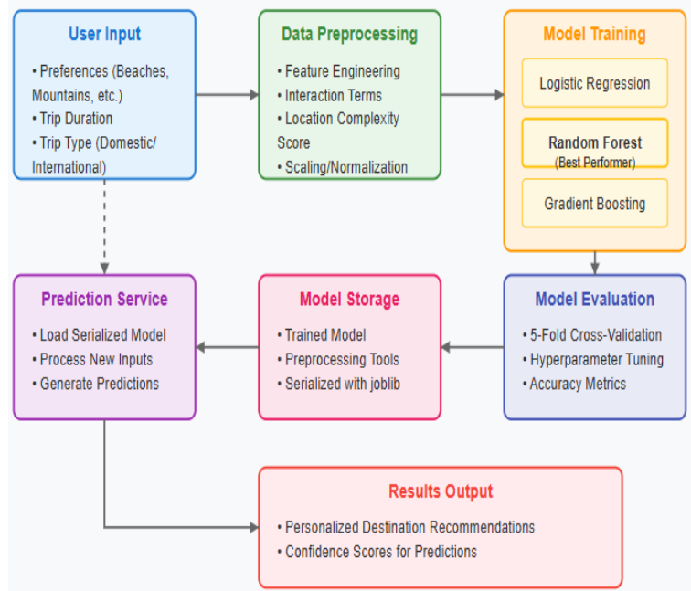
System Architecture

Slide 8
List of Modules
Data Collection
Data Preprocessing Module
Model Training and Optimization Module
Destination Prediction Module:
Model Evaluation Module

Slide 9
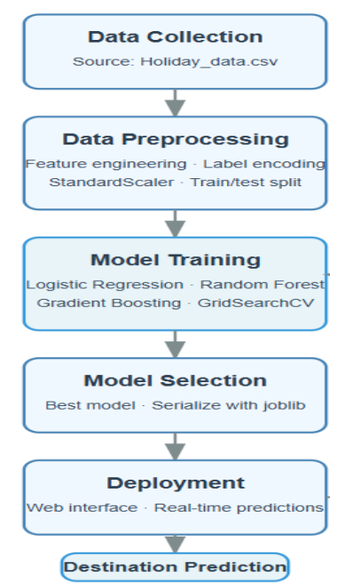
Functional Description for each modules with DFD and Activity Diagram

Slide 10
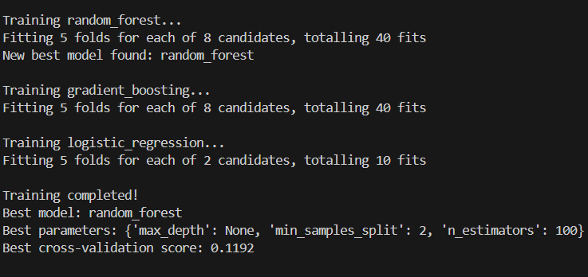
Implementation & Results of Module
User Input Module:
Collects user preferences like trip type, duration, and destination features.
Data Preprocessing Module:
Cleans and scales data, applies label encoding, and generates new interaction features. Encodes categorical variables using Label Encoding and scales numerical data using StandardScaler. Applies feature engineering, such as creating interaction features.
Model Training and Optimization Module:
Uses 3 ml models selects best model using cross validation
Prediction Module:
Provides real-time destination recommendations based on user preferences using the best-trained model.
Model Evaluation Module:
Evaluates model performance using metrics like accuracy, precision, recall,F1-score.
Deployment Module:
Serializes the trained model and preprocessing tools using joblib for easy deployment. Offers a user-friendly interface for real-time predictions.

Slide 11
Conclusion & Future Work
The "Holiday Destination Prediction" system effectively predicts vacation destinations based on user preferences such as location type, trip duration, and travel type. The system leverages various machine learning algorithms, such as Logistic Regression, Random Forest, and Gradient Boosting, to provide accurate destination suggestions. The implementation of feature engineering, data preprocessing techniques, and model selection ensures the robustness of the prediction system.
Future Enhancements:
Real-Time Data Integration: Including real-time information such as travel restrictions, weather conditions, and flight availability would enhance the system’s relevance and timeliness.
User Personalization: Allowing users to customize their preferences more granularly, such as by including budget constraints, would make the recommendations more tailored.
Advanced Visualization: Adding interactive data visualizations, such as maps or destination comparisons, would enhance user engagement and the decision-making process.
Collaborative Filtering: Integrating collaborative filtering techniques could improve recommendations based on user behavior patterns and past preferences.

Slide 12
References
[1] P. R. Stopher, Method for Understanding and Predicting Destination Choices. 1979.
[2] M. Kuhn and K. Johnson, Feature Engineering and Selection: A Practical Approach for Predictive Models. CRC Press, 2019.
[3] B. Varghese and S. H., Advancing Smart Tourism Through Analytics. IGI Global, 2024.
[4] Z. Xiang and D. R. Fesenmaier, Analytics in Smart Tourism Design: Concepts and Methods. Springer, 2016.

Slide 13
Thank You

